Slide 1
Employee Data Analysis using Excel
STUDENT NAME: G.NANDHINI
REGISTER NO: 122201749
DEPARTMENT: B.COM ( CORPORATE SECRETARYSHIP )
COLLEGE: CHELLAMMAL WOMEN'S COLLEGE

Slide 2
PROJECT TITLE
Employee Performance Analysis using Excel

Slide 3


AGENDA
Problem Statement
Project Overview
End Users
Our Solution and Proposition
Dataset Description
Modelling Approach
Results and Discussion
Conclusion
3/21/2024 Annual Review

Slide 4

PROBLEM STATEMENT
• Detection of fisce mnks in public spaces has become critical for ensuring public health and safety. • Traditional methods of manual monitoring are inefficient and prone to errors. • An automated system for face mask detection is needed to enforce mask-wearing policies affectively.

Slide 5

PROJECT OVERVIEW
• Our project aims to develop a CNN-based system fim automatic face mask detection. • Leveraging deep learning techniques, we seek to accurately identify whether individuals are wearing masks in images or video streams. • The system will serve as a tool for authorities to monitor aompliance with mok wearing regulations in various settings.
.

Slide 6

WHO ARE THE END USERS?
• Health authorities • Law enforcement agencies • Business owners (eg retail stores, restaurants) • Public transportation operators

Slide 7

OUR SOLUTION AND ITS VALUE PROPOSITION
• We propose a CNN architecture trained on a dataset of labeled images containing people with and without masks. • The model will be capable of real-time detection and can he deployed in various scenarios, including CCTV surveillance, mobile applications, and public kiosks. • Our solution aims to provide a reliable and efficient method fir enforcing mask-wearing policies and promoting publie safety.

Slide 8
Dataset Description
• Employee dataset-Kaggle • 26 features • 9 features • Emprid Name-text • Rating-numeri • Performance-text Gender-Em • Business unit-test • Business type-test

Slide 9

THE "WOW" IN OUR SOLUTION
• Real-time detection capabilities. • High accuracy in identifying mask-wearing behavior. • Scalability for deployment in diverse environments. • Potential for integration with existing surveillance systems.
3/21/2024 Annual Review
9

Slide 10
MODELLING
1.Convolutional Neural Network (CNN) Architecture: • CNNs are ideal for image classification due to their ability to capture spatial dependencies. • We've chosen a CNN architecture optimized for image classification tok ensuring efficient processing of imput images. 2. Data Preprocessing: • Prior to training, our dataset undergoes proprocessing step. • Tocfinisquce such as reviring, augmentation, and normalization are applied to ensure data quality and model robustness. 3. Training Process: • The dataset is split into tranung, validation, and testing sets. • We intimate the model parameters and select an optimization algorithen. • Training iterations and batch sizes are adjusted to optimize model performance.
10

Slide 11
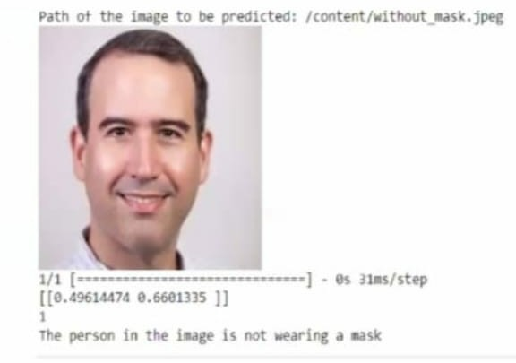
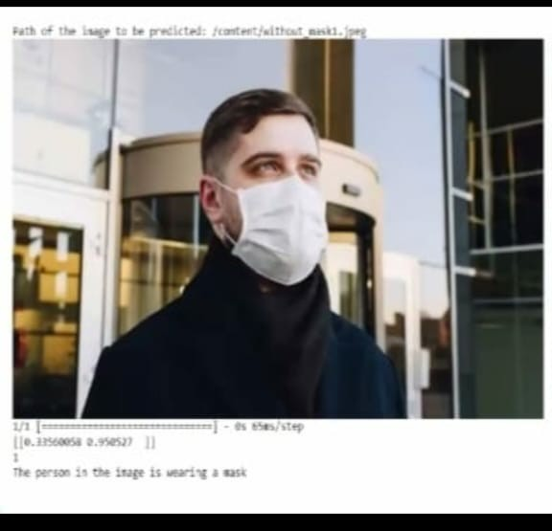
RESULTS
11

Slide 12
conclusion
• Our project successfully developed a Convolutional Neural Network (CNN)-based system for face mask, detection. • Through meticulous data preprocessing and model training, we achieved promising results in accurately identifying individuals wearing face masks.

